Slide 1
UNIT 1 ATAR HUMAN BIOLOGY
CHAPTER 3 CELLS

Slide 2
CELL THEORY
All living things are made up of cells.

Slide 3
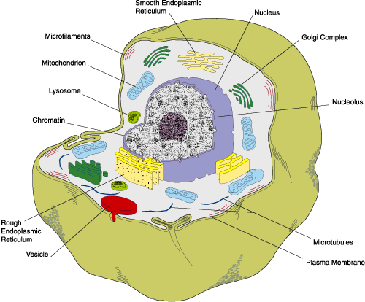
CELL STRUCTURE AND FUNCTIONS
www.genetherapyreview.com/images/stories/animal_cell.gif

Slide 4
Cell Membrane
plasma membrane
The cell membrane or _________________________ of a cell separates it from ___________________ cells and separates the cell from the _________ environment. It is composed of a ____________ layer of lipid molecules with a phosphate group called phospholipids, and some ___________. The cell membrane has an important role in the ____________________ of substances into and out of the cell.
neighbouring
external
double
protein
movement

Slide 5
CYTOPLASM
Jelly-like or watery material inside the cell membrane
Holds and contains membranous structures called organelles
Fills the space between the nucleus and the cell membrane

Slide 6
ORGANELLES
Organelles are structures within a cell which are specialised for a particular function. They are suspended in the cytoplasm.

Slide 7
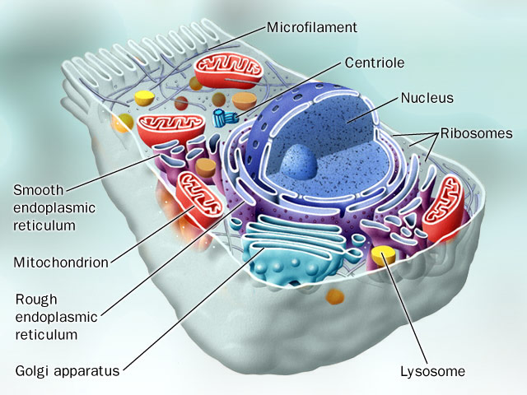
http://www.chemistrypictures.org/d/19-3/cell_structure.jpg

Slide 8
Nucleus
The nucleus(pl. nuclei) is separated from the cytoplasm and other organelles by a nuclear membrane. This membrane has holes or nuclear pores which allow substances to pass in and out of the nucleus. The nucleus contains genetic material deoxyribonucleic acid, or DNA. DNA contains a code for the structure of proteins which carry out chemical reactions within the cell. By controlling the chemical reactions within a cell, the DNA controls the function of a cell. The nucleus also contains a nucleolus which contains mostly ribonucleic acid or RNA which plays a role in protein synthesis.

Slide 9
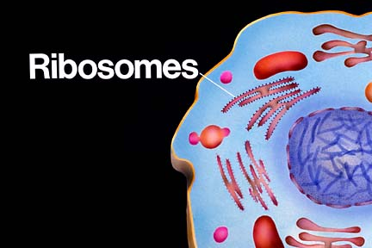
http://library.thinkquest.org/06aug/01942/plcells/thinkquest/ribosomes.jpg

Slide 10
RIBOSOMES
Ribosomes are where amino acids are joined together to form protein.
They can be either attached to membranes within the cell or suspended in the cytoplasm.

Slide 11
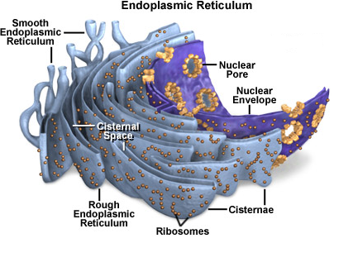
http://micro.magnet.fsu.edu/cells/endoplasmicreticulum/endoplasmicreticulum.html

Slide 12
ENDOPLASMIC RETICULUM
The endoplasmic reticulum or ER are folds of membranes within the cytoplasm which join the cell membrane and the nuclear membrane.
The ER has two functions:
1. provides a surface for chemical reactions , and to
2. transport or store molecules

Slide 13
Ribosomes are often attached to these membranes which become known as rough ER or granular ER.
If no ribosomes are attached to the membranes, they are known as smooth ER or agranular ER.

Slide 14
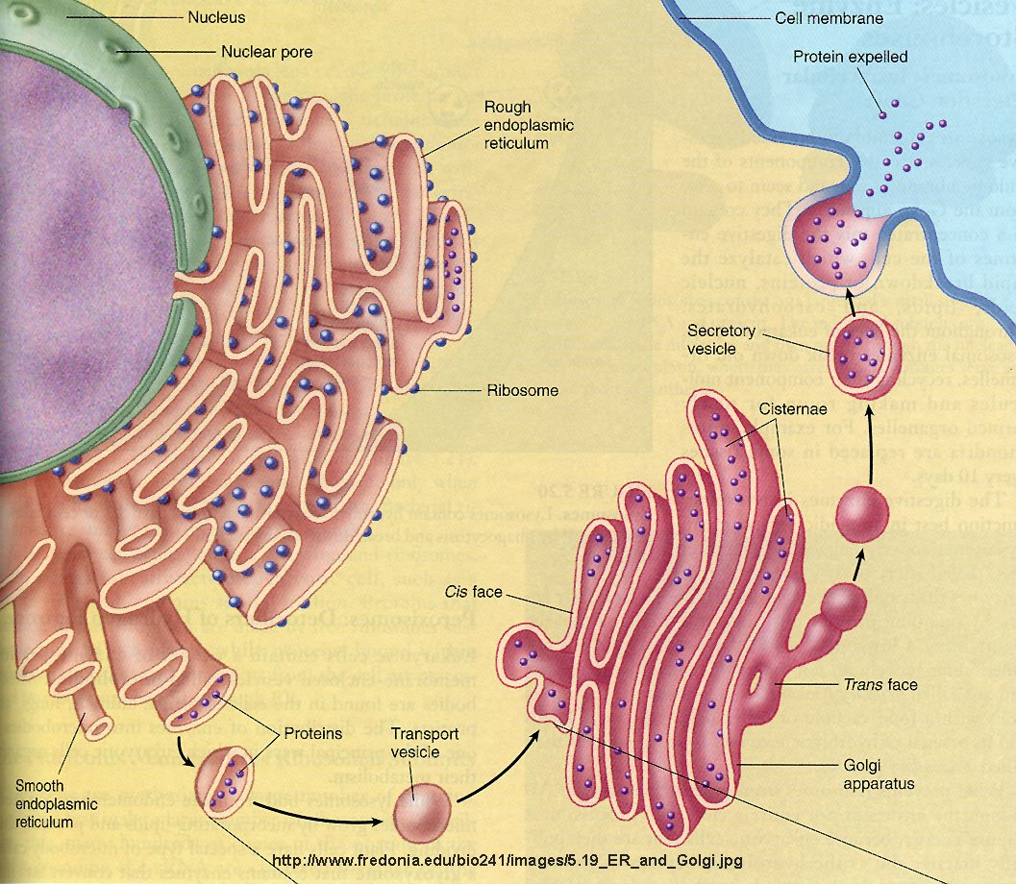

Slide 15
GOLGI APPARATUS
The golgi apparatus is comprised of a series of membranous bags. They receive protein from ribosomes on the rough ER and package or modify them by adding fatty acids, sugar, sulfates and/or phosphates.
Following this modification, the proteins are placed into a vesicle which forms from the membrane of the golgi apparatus.
The vesicle moves to the cell membrane where it allows the protein to exit from the cell.

Slide 16
Lysosomes
Lysosomes contain digestive enzymes(lysozymes) which break down protein, lipids, nucleic acid and some carbohydrates.
Lysosomes break down materials that are taken into the cell or break down worn-out organelles.

Slide 17
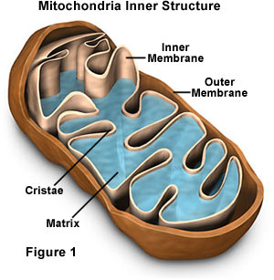

Slide 18
MITOCHONDRIA
Mitochondria(singular is mitochondrion) are referred to as the powerhouse of the cell because they produce energy for the cell’s activities through the process of cellular respiration.
These energy-making reactions occur in the folds of the inner membrane.
A smooth outer membrane surrounds the mitochondrion.

Slide 19
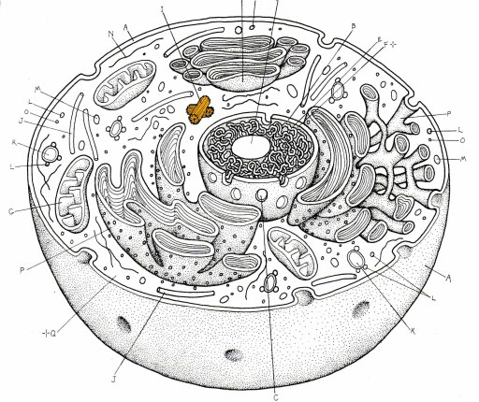

Slide 20
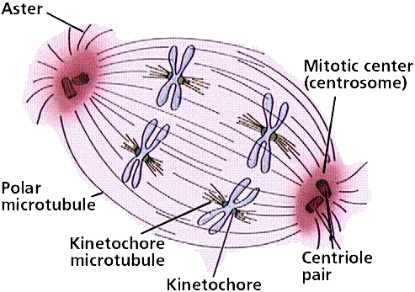
http://www.emc.maricopa.edu/faculty/farabee/biobk/spindle.gif

Slide 21
CENTRIOLES
Centrioles are involved in cell reproduction .
They are cylindrical in shape, work in pairs and are located near the nucleus.

Slide 22
Cilia and Flagella
These structures are projections which can produce movement of the cell or move substances over the surface of the cell by moving in a rhythmic motion.
If these projections are short and numerous, they are called cilia. Cells with cilia can be found in the respiratory tract. If these projections are longer and fewer in number, they are called flagella. An example of a cell with a flagellum is a sperm.

Slide 23
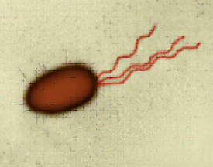
http://www.monash.edu.au/news/assets/images/micro-robot.jpg

Slide 24
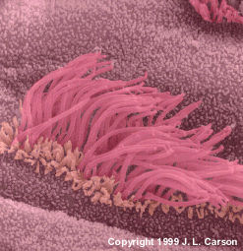
Cilia in Respiratory Tract
www.pcdfoundation.org/images/Johnny%27s%20cil

Slide 25
INCLUSIONS
Inclusions are chemical substances which are found in the cytoplasm of the cell, but are not part of the cell’s structure.
Two examples of inclusions are melanin and mucus.
If the inclusion is a liquid, it is enveloped by a membrane and is called a vacuole.

Slide 26
CYTOSKELETON
The cytoskeleton is made up of microfilaments and microtubules which give the cell its shape and help with cell movement.

